Slide 1
Software Agile Project Management Principle

Slide 2
Outline
The fundamental and application of agile project principle.
The concepts of project identification, analysis, treatment and monitoring.
Documenting planning.
User stories.

Slide 3
Fundamental and Application of Agile Project Principle

Slide 4
Learning Outcomes
By the end of this chapter, you will be able to explain the foundations of Agile, interpret the Agile Manifesto, and apply its principles in practice. You’ll also learn how Agile principles encourage adaptability, collaboration, and delivering value in projects.
Understand the fundamentals of Agile principles
Explain the 12 Agile principles behind the manifesto
Compare Agile with traditional project management
Apply Agile concepts in software projects
Recognize the benefits of collaboration and adaptability

Slide 5
What is Agile Project Management?
Agile Project Management is a modern approach that focuses on flexibility and iterative progress. Unlike predictive methods, Agile adapts to change and emphasizes customer value, collaboration, and continuous delivery.
A flexible, iterative approach to project management
Delivers value early and continuously
Emphasizes collaboration, feedback, and adaptation
Contrast: adaptive vs. predictive methods

Slide 6
Why Agile?
Agile emerged to address the shortcomings of traditional methods. Instead of waiting until the end, Agile ensures frequent delivery and constant collaboration with stakeholders, making projects more adaptive and customer-focused.
Traditional approaches face:
  Fixed scope, rigid planning, late delivery
Agile responds with:
  Flexibility to change at any stage
  Small increments delivered frequently
  Continuous stakeholder engagement

Slide 7
Agile Manifesto Overview
The Agile Manifesto is the foundation of Agile practices. It consists of four values and twelve guiding principles that shape how Agile projects are managed. These principles apply across different frameworks such as Scrum, Kanban, and Extreme Programming.
Introduced in 2001 by 17 software experts
Consists of:
  4 Core Values
  12 Guiding Principles
Foundation of Agile methodologies (Scrum, Kanban, XP)

Slide 8
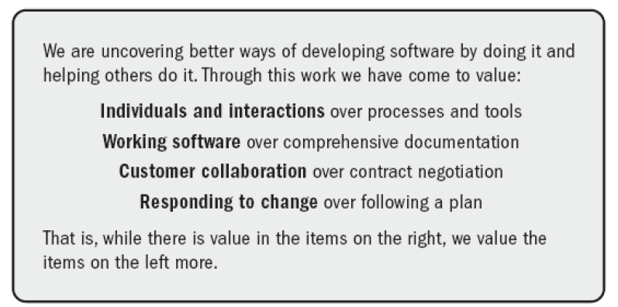
Agile Manifesto Overview

Slide 9
Agile Value 1
The first value emphasizes that people and collaboration are more important than rigid tools and processes. Success comes from motivated individuals working together, not just following a checklist.
Individuals and interactions over processes and tools
People drive success, not tools alone
Communication & teamwork create better outcomes

Slide 10
Agile Value 2
Agile prioritizes delivering working software rather than producing extensive documents. While documentation has value, the true measure of progress is functional, usable output.
Working software over comprehensive documentation
Documentation is helpful but secondary
Functional results prove real progress

Slide 11
Agile Value 3
This value stresses the importance of working closely with customers throughout the project. Instead of relying only on contracts, Agile welcomes customer feedback to ensure the solution truly meets their needs.
Customer collaboration over contract negotiation
Involve customers in development
Requirements evolve with feedback

Slide 12
Agile Value 4
Agile acknowledges that change is inevitable. Rather than rigidly following a fixed plan, Agile adapts and adjusts to meet evolving requirements and deliver real value.
Responding to change over following a plan
Plans adapt to new insights
Flexibility creates better outcomes

Slide 13
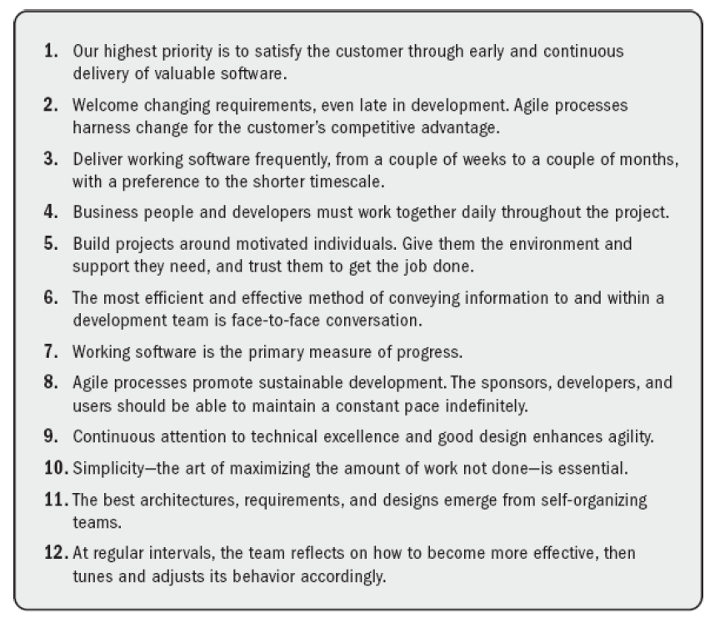
Agile Principles Overview
The twelve Agile principles translate the four core values into practical actions. They provide a detailed roadmap for Agile teams to adapt, collaborate, and deliver effectively.

Slide 14
Principle 1: Customer Satisfaction
The first principle emphasizes customer satisfaction by delivering value early and often. In Scrum, this is achieved through short iterations, as seen in the FBI Sentinel project where frequent demos kept stakeholders engaged.
Priority: satisfy the customer
Deliver early and continuously
Scrum example: FBI Sentinel frequent demos

Slide 15
Principle 2: Welcome Change
Agile sees change as an opportunity, not a problem. Even late in development, adapting to new needs helps projects stay competitive. Scrum embraces this with sprint planning and backlog adjustments.
Accept changes, even late in development
Change = competitive advantage
Scrum: sprint flexibility

Slide 16
Principle 3: Frequent Delivery
Instead of one big delivery at the end, Agile promotes frequent, small releases. This incremental approach ensures value is delivered regularly and feedback is gathered early.
Deliver working software every 2–4 weeks
Incremental releases improve value
Scrum increments demonstrate progress

Slide 17
Principle 4: Collaboration
Agile promotes strong collaboration between developers and business stakeholders. Daily discussions improve alignment, decision-making, and team trust.
Daily collaboration between business & developers
Builds trust and faster decisions
Scrum: daily standups

Slide 18
Principle 5: Motivated Individuals
Agile values motivated individuals, giving them the tools and trust to succeed. Scrum demonstrates this by empowering teams to self-organize and take ownership of their work.
Projects succeed with motivated people
Provide support & trust
Scrum: self-organizing teams

Slide 19
Principle 6: Face-to-Face Communication
Communication is most effective face-to-face. Agile encourages team discussions to quickly resolve issues and ensure shared understanding, such as daily standups and retrospectives in Scrum.
Best way to share information
Builds stronger understanding
Scrum: standups, retrospectives

Slide 20
Principle 7: Working Software as Progress Measure
Agile teams measure success by the software delivered, not by documentation produced. Delivering working software proves tangible progress.
Primary measure = working software
Not documents or reports
Progress = usable product

Slide 21
Principle 8: Sustainable Pace
Agile emphasizes a balanced pace of work. By avoiding unrealistic deadlines, teams can maintain consistent productivity and quality.
Agile promotes steady, sustainable pace
Avoid burnout and fatigue
Scrum: maintain constant velocity

Slide 22
Principle 9: Technical Excellence
Agile promotes technical excellence and strong design practices. By ensuring quality at every step, teams can adapt more easily and avoid costly rework.
Quality & good design enhance agility
Continuous attention to improvement
Example: Definition of Done ensures quality

Slide 23
Principle 10: Simplicity
Agile emphasizes simplicity by focusing on essential features. The goal is to maximize the amount of work not done, while still delivering value.
Do only what is needed
Avoid unnecessary work
Focus on value

Slide 24
Principle 11: Self-Organizing Teams
Agile recognizes that self-organizing teams produce the most effective outcomes. By empowering teams to decide how to work, they innovate and take full responsibility for delivery.
Best results come from self-organizing teams
Teams decide how to achieve goals
Scrum: empowered development teams

Slide 25
Principle 12: Reflection & Adaptation
Continuous improvement is at the heart of Agile. Teams pause regularly to reflect and adapt their processes, ensuring better performance over time.
Teams reflect regularly
Adjust process to improve
Scrum: retrospectives

Slide 26
Agile Mindset
The Agile mindset goes beyond frameworks. It’s about adopting flexibility, continuous value delivery, and collaboration as part of the team culture.
Focus on adaptability and collaboration
Deliver continuous value
Encourage experimentation and learning

Slide 27
Scrum as an Example of Agile in Action
Scrum is the most widely used Agile framework. It applies Agile values and principles through time-boxed sprints, defined roles, and regular ceremonies to ensure adaptability and delivery.
Scrum applies Agile values & principles
Short sprints (2–4 weeks)
Roles: Product Owner, Scrum Master, Dev Team
Events: Sprint, Standup, Retrospective

Slide 28
Summary of Agile Fundamentals
In summary, Agile is both a mindset and a set of guiding principles. Its values and principles promote adaptability, collaboration, and delivering customer value. Scrum is a strong example of how these principles are applied in practice.
Agile = mindset + values + principles
4 Values + 12 Principles = Agile foundation
Encourages adaptability, collaboration, and customer focus
Scrum = practical application

Slide 29
Concepts of Project Identification, Analysis, Treatment

Slide 30
Why Identification & Monitoring are Critical
Project identification ensures that goals, scope, and risks are clear from the start. Monitoring then provides a feedback loop, helping teams stay aligned and adapt when challenges arise. Both are critical for Agile success.
Identifies scope, risks, and resources early
Ensures alignment with objectives and stakeholders
Monitoring tracks progress & adapts plan as needed

Slide 31
Vision & Stakeholders
Every Agile project starts with a clear vision. Identifying stakeholders early ensures that their needs are considered, making it easier to align priorities and reduce misunderstandings.
Define project vision – overall goal and purpose
Identify key stakeholders – customers, users, sponsors
Align expectations early to avoid conflicts

Slide 32
Techniques for Identification
Agile teams use tools like SWOT and stakeholder mapping to identify internal strengths and external risks, while also categorizing stakeholders by their influence and importance to the project.
SWOT Analysis – strengths, weaknesses, opportunities, threats
Stakeholder Map – influence and interest levels
Helps in prioritizing stakeholder involvement

Slide 33
Project Analysis: Feasibility & Risk Assessment
Project analysis evaluates whether the project is worth pursuing. Agile promotes early feasibility checks and risk assessment to avoid wasted time and resources.
Check technical, financial, and operational feasibility
Assess risks using Agile-friendly methods
Prioritize manageable and valuable requirements

Slide 34
Backlog Creation: Identifying Requirements
In Agile, requirements are stored in a dynamic backlog, not fixed documents. User stories make requirements easier to prioritize and adapt as new information emerges.
Use Product Backlog to list features
Requirements captured as user stories
Continuously refined throughout project

Slide 35
MoSCoW Prioritization
MoSCoW is a prioritization method widely used in Agile. It helps teams focus on what is essential first, while leaving room for flexibility as time and resources permit.
Must have – critical features
Should have – important but not essential
Could have – nice to include if possible
Won’t have (now) – excluded from this release

Slide 36
Timeboxing: Managing Effort & Risks
Timeboxing ensures that work is completed within strict time limits. This reduces the risk of scope creep and forces teams to focus on delivering the highest-value tasks within the available time.
Fixed time periods for tasks (sprints, iterations)
Encourages focus on priorities
Reduces risk of endless delays

Slide 37
Monitoring with Burndown Chart
Burndown charts give teams a simple, visual way to track whether work is on schedule. If the trend shows slippage, corrective action can be taken quickly.
Tracks remaining work vs. time
Visual indicator of sprint progress
Helps detect delays early

Slide 38
Kanban Board: Task Visualization
Kanban boards give teams a visual method of tracking task progress. By moving tasks across columns, bottlenecks are quickly identified, improving workflow efficiency.
Columns: To Do → In Progress → Done
Visualize work and bottlenecks
Supports continuous flow of tasks

Slide 39
Retrospectives: Continuous Learning
Agile encourages regular retrospectives where teams reflect on their performance. This continuous feedback loop drives learning and improvement over time.
Held at the end of each sprint
Identify what worked and what didn’t
Adjust processes for future improvement

Slide 40
Daily Standups: Team Synchronization
Daily standups keep the team aligned and quickly highlight blockers. This ensures everyone is on the same page and can collaborate to solve problems.
15-minute daily meeting
Team answers 3 key questions:
  What did I do yesterday?
  What will I do today?
  What’s blocking me?

Slide 41
Case Example: FBI Sentinel Project (1/4)
The FBI Sentinel project initially struggled with Waterfall. Switching to Agile allowed faster delivery, cost savings, and improved stakeholder satisfaction.
Large FBI project failed under Waterfall
Restarted using Agile & Scrum
Delivered faster at lower cost

Slide 42
Case Example: FBI Sentinel Project (2/4)
Scrum sprints and demos enabled the FBI team to deliver working increments regularly. This kept stakeholders actively involved and allowed the team to adjust quickly.
Used short sprints for incremental delivery
Frequent demos kept stakeholders engaged
Improved adaptability to changes

Slide 43
Case Example: FBI Sentinel Project (3/4)
Burndown charts provided visibility of team progress. This transparency helped ensure accountability and reduced misunderstandings between stakeholders.
Monitoring progress with burndown charts
Clear visibility of completed vs pending work
Reduced miscommunication

Slide 44
Case Example: FBI Sentinel Project (4/4)
Through retrospectives and empowered teams, the FBI Sentinel project became a success story, proving that Agile works even in large government organizations.
Retrospectives improved process
Motivated, self-organizing teams
Success story for Agile in government

Slide 45
Case Example: Healthcare.gov Failure
Healthcare.gov’s launch failure highlights the risks of rigid planning. Without Agile-style monitoring and iteration, the project could not adapt to problems in time, leading to a high-profile failure.
Used traditional Waterfall approach
Resulted in delays and technical failures
Lack of iterative monitoring caused collapse

Slide 46
Section Wrap-up
This section showed how Agile helps identify, analyze, treat, and monitor projects effectively. With practical tools and real-world cases, Agile proves its ability to improve outcomes compared to traditional methods.
Identification: vision, stakeholders, requirements
Analysis: feasibility, prioritization
Treatment: timeboxing, risk control
Monitoring: burndown, Kanban, retrospectives
Case studies: FBI Sentinel (success), Healthcare.gov (failure)

Slide 47
Documenting Planning

Slide 48
Agile Documentation vs Predictive Documentation
In traditional project management, teams spend months writing detailed documentation before work starts. Agile flips this approach by keeping documentation lightweight and adaptable, focusing on delivering real value through working software.
Traditional (predictive) → heavy documentation upfront
Agile → lightweight, living documents
Focus on value over paperwork

Slide 49
Planning Levels in Agile
Agile planning occurs at multiple levels. It begins with the product vision, is broken into roadmaps and release plans, and finally refined in sprint plans, ensuring planning adapts across different time horizons.
Vision – long-term purpose of the product
Roadmap – high-level timeline & direction
Release plan – upcoming deliverables
Sprint plan – short-term, detailed tasks

Slide 50
Planning Levels in Agile
Agile plans at multiple horizons. Vision, roadmap, release and sprint set direction; the daily plan is the operational heartbeat where the team re-plans work every day to protect the sprint goal—updating tasks, owners, and the board as reality changes.
Vision – long-term purpose & outcomes
Roadmap – high-level time-phased themes/epics
Release plan – what fits into the next(s) release(s)
Sprint plan – 1–4 week iteration goal & selected stories
Daily plan – day-to-day re-planning to hit the sprint goal (Daily Scrum)

Slide 51
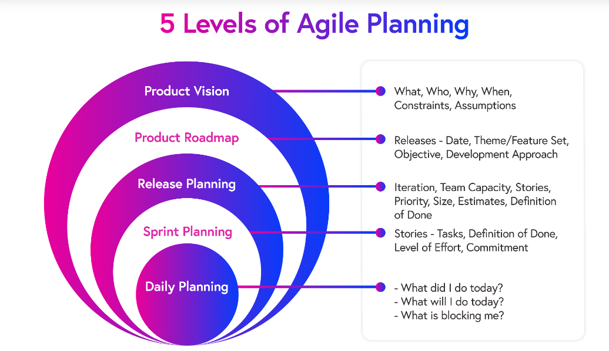
Planning Levels in Agile

Slide 52
Product Vision Document (Example)
The product vision defines the “why” of the project. A clear vision keeps the team aligned with long-term goals while avoiding scope drift.
Describes overall product goal
Aligns team & stakeholders
Example: “Provide students with a seamless e-learning experience”

Slide 53
Roadmap (Example Visualization)
Agile roadmaps provide a big-picture view of the project’s direction. Unlike rigid Gantt charts, they evolve with stakeholder input and changing requirements.
Timeline view of major deliverables
Shows releases, milestones, dependencies
Keeps stakeholders informed

Slide 54
Release Planning in Agile
Release planning organizes the backlog into sets of features that can be delivered together. This ensures customers see continuous progress and value at regular intervals.
Groups features into deliverable releases
Ensures value delivered incrementally
Balances scope, time, and quality

Slide 55
Sprint Planning (Scrum)
Sprint planning sets the direction for each iteration. The team chooses high-priority items from the backlog, defines a sprint goal, and breaks them into tasks that can be completed within the sprint.
Held at start of each sprint
Team selects items from product backlog
Defines sprint goal + tasks

Slide 56
Daily Planning (Daily Scrum / Micro-Plan)
Daily planning happens in the Daily Scrum. The team inspects progress and immediately adapts the day’s plan—adding/splitting tasks, re-assigning work, and surfacing blockers. It’s not a status report; it’s a micro-planning session to keep the sprint on track.
Purpose: re-plan the day to meet the sprint goal
Cadence: 15 minutes, same time/place, whole team
Focus: yesterday, today, impediments (then adjust tasks)
Updates: task board, WIP limits, burndown trend
Outcomes: clear next steps, owners, escalated blockers

Slide 57
Product Backlog: Dynamic Documentation
The product backlog is the single source of truth for project requirements. It evolves constantly, making it a living document that adapts as priorities change.
Master list of all requirements
Written as user stories
Continuously refined (backlog grooming)

Slide 58
Sprint Backlog: Living Plan
The sprint backlog defines the team’s immediate work. Unlike static project plans, it changes as new insights appear during the sprint, ensuring flexibility while keeping accountability.
Subset of product backlog
Contains tasks for the current sprint
Visible to the whole team

Slide 59
Definition of Done (Scrum Example)
In Scrum, a Definition of Done ensures that work is not just “finished” but actually meets quality standards. It avoids ambiguity and ensures deliverables are usable.
Checklist of criteria for “done”
Ensures quality and consistency
Example: tested, documented, integrated

Slide 60
Kanban as Documentation Tool
Kanban boards act as living documentation of work. By visually tracking tasks, they replace long reports and provide transparency for all stakeholders.
Visualizes work flow: To Do → In Progress → Done
Documents real-time status
Helps spot bottlenecks

Slide 61
Lightweight Planning: Avoiding Waste
Agile minimizes waste by producing only the documents that are actually useful. This keeps the team focused on communication and working software rather than endless paperwork.
Plan only what is needed
Avoid creating unused documents
Emphasize communication over paperwork

Slide 62
Case Example: Spotify Model (1/3)
Spotify adopted Agile to manage rapid growth. Their squads (small, autonomous teams) relied on lightweight planning tools such as visual roadmaps and evolving backlogs instead of heavy documentation.
Spotify built Agile around autonomous squads & tribes
Minimal documentation, heavy use of visual tools
Teams plan with roadmaps & backlogs instead of Gantt charts

Slide 63
Case Example: Spotify Model (2/3)
Spotify’s planning model works at several levels. Squads plan sprints, tribes align them into broader goals, and the company sets a high-level vision. Roadmaps act as evolving guides, encouraging adaptability.
Planning at multiple levels: squad → tribe → company
Roadmaps used as guidelines, not fixed contracts
Focus on adaptability and innovation

Slide 64
Case Example: Spotify Model (3/3)
Spotify emphasizes collaborative tools such as Kanban and backlog refinement. Documentation is limited to what helps teams align and adapt, ensuring efficiency without excessive paperwork.
Strong use of Kanban & backlog refinement
Documentation limited to what supports collaboration
Teams empowered to adjust plans dynamically

Slide 65
Section Wrap-up: Planning as a Continuous Activity
In Agile, planning never stops. Teams set long-term intent, detail the near term, and re-plan daily to respond to change. Visible artifacts (backlogs/boards/DoD) and tight cadences keep everyone aligned while minimizing waste.
Lightweight & evolving: vision → roadmap → release → sprint → daily plan
Artifacts: backlog, boards, DoD, plans visible to all
Practices: sprint planning + daily re-planning + reviews/retros
Key idea: plan just enough now, refine continuously

Slide 66
User Stories

Slide 67
Introduction: User Story and Agile
A user story is an informal, general explanation of a software feature written from the perspective of the end user. Its purpose is to articulate how a software feature will provide value to the customer.
User stories are one of the core components of an agile program. it drives collaboration, clarity, and better products.
Written in non-technical language, it keeps the end user at the center. It explains what is built, why, and the value for the customer.
Notes:
Reference:
User Stories | Examples and Template | Atlassian

Slide 68
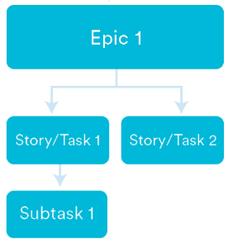
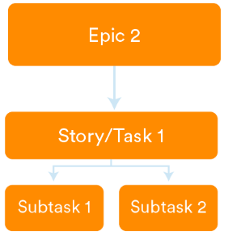
Working with User Story
Scrum: User stories go into sprints, driving estimation, planning, and forecasting.
Kanban: User stories move through workflow, helping manage WIP and refine processes. In both, stories improve agility and efficiency.
User stories in a building block Initiative 🡪 Epic 🡪 Story
Initiative
Build a seamless online shopping experience
User Account & Authentication
Product Catalog & Search
User can register an account
User can login securely
User can search products by keyword
Design signup form
Build search bar UI
Implement search filtering
Notes:
Reference:
User Stories | Examples and Template | Atlassian

Slide 69
Variations of User Story Format
The common format ensures every user story explains the who, what, and why.
Format | Structure | Example | Best Use Case
Role–Feature–Reason | As a [role], I want [feature] so that [reason/benefit]. | As a shopper, I want to save items in a wishlist so that I can purchase them later. | Simple, user-focused; best for capturing user needs quickly.
Collaboration-based Approach | As a [intended user] I want [intended action], so that [purpose/result of the action, profit achieved], Acceptance Criteria: | As a customer of the bank I want to log into the system So that I can use bank products Acceptance criteria: Login must be a valid email address. System rejects login attempt with incorrect password. System rejects login attempt for non-existent user login. | Ensures clear testable conditions; best for defining acceptance criteria.
Testable Format (BDD) | Scenario → Given [initial context], When [event], Then [outcome]. | Scenario: Add product to cart → Given I am on a product page, When I click “Add to Cart”, Then the item appears in my cart. | Best for detailed testing and collaboration between devs, testers, and business.

Slide 70
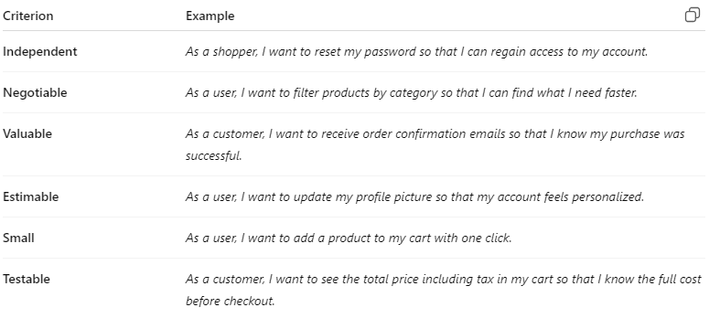
INVEST Criteria
The INVEST model provides six checks for quality user stories. A story that meets these standards is clear, actionable, and delivers value.
Independent – can stand alone.
Negotiable – open to discussion
Valuable – delivers benefit
Estimable – can be sized
Small – manageable scope
Testable – has acceptance criteria

Slide 71

Example of User Story
COLLABORATION-BASED APPROACH
User story US-002-02
As a logged-in bank customer
I want to be able to transfer money to another account
So that be able to transfer funds between accounts
Acceptance criteria
(AC1) the amount of the transfer cannot exceed the account balance
(AC2) target account must be correct
(AC3) for valid data (amount, account numbers) the source account balance decreases and the destination account balance increases by the amount of the transfer
(AC4) the transfer amount must be positive and represent the correct amount of money (i.e., be accurate to two decimal places max)
🔹 How it might look in Jira
Epic: Banking Transactions
Story: US-002-02 Transfer Money Between Accounts
  Task: Frontend – Transfer Form
    Sub-task: Design form
    Sub-task: Implement form
    Sub-task: Add client-side validation
    Sub-task: Display messages
  Task: Backend – API & Business Rules
    Sub-task: Create transfer API
    Sub-task: Implement validation rules
    Sub-task: Update balances
    Sub-task: Log transactions
  Task: Database Updates
    Sub-task: Schema changes (if any)
    Sub-task: Rollback mechanism
  Task: Testing
    Sub-task: Unit tests
    Sub-task: Integration tests
    Sub-task: QA test scenarios

Slide 72
Writing Effective User Stories: Tips
Effective user stories are concise but meaningful. They are written collaboratively, refined regularly, and backed with acceptance criteria to avoid ambiguity.
Keep them short and simple
Focus on value, not tasks
Collaborate with users to refine
Add acceptance criteria for clarity

Slide 73
Good vs. Bad User Stories (Example 1)
Good user stories emphasize value for the user and are testable. Poor stories often sound like technical tasks without a clear user benefit.
Good: clear, valuable, testable
Bad: vague, technical, or incomplete
Example:
  ✅ “As a customer, I want to reset my password so I can regain access easily.”
  ❌ “Add password reset function.”

Slide 74
Good vs. Bad User Stories (Example 2)
The difference lies in focus. Good stories capture intent and user benefit, while bad ones prematurely dictate technical details.
Good: describes intent, not implementation
Bad: overly detailed upfront
Example:
  ✅ “As a teacher, I want to upload lecture notes so students can study anytime.”
  ❌ “Create a 20MB PDF upload system with 5 fields.”

Slide 75
User Story Mapping
User story mapping turns stories into a structured visual map. It shows the big picture, highlights missing requirements, and guides release planning to maximize delivered value.
Visual practice for organizing work
Helps identify sets of high-value features
Detects omissions in backlog
Supports effective release planning
Notes:
User Story Mapping – Easy Examples
Visual practice for organizing work
👉 Example: Arrange stories like “Login” → “View Account” → “Transfer Money” → “View Transaction History” in sequence, so the team sees the user journey clearly.
Helps identify sets of high-value features
👉 Example: Group stories like “Transfer Money” + “Bill Payment” + “Fund Transfer to Other Bank” as high-value features for release since they’re core to banking.
Detects omissions in backlog
👉 Example: While mapping, the team realizes they forgot “Error messages for failed transactions”. Mapping helps catch what’s missing.
Supports effective release planning
👉 Example: Plan Release 1 with “Login, View Balance, Transfer Money” (core banking). Release 2 can include “Bill Payments, Notifications”. Mapping helps decide what to release first.

Slide 76
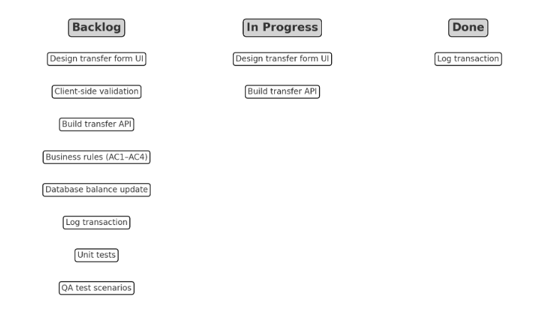
Roadmap to Backlog Breakdown
Story mapping also links high-level vision to actionable backlog items. By progressively breaking down roadmap features, teams ensure clarity and alignment between vision and tasks.
Decompose roadmap into smaller requirements
Use mapping & impact analysis
Product Owner + team clarify expectations together
Backlog → All tasks waiting to be started
In Progress → Tasks the team is currently working on
Done → Completed tasks

Slide 77
Examples of User Stories (Education App)
Educational apps benefit from user stories by capturing both student and teacher perspectives, ensuring features meet practical needs.
As a student, I want online quizzes so that I can test myself anytime.
As a lecturer, I want attendance tracking so that I can monitor participation.

Slide 78
Examples of User Stories (Banking App)
In banking, user stories focus on security and convenience. Each story highlights the value to both customers and staff.
As a customer, I want instant balance check so that I can manage money better.
As a bank manager, I want fraud alerts so that I can protect customers.

Slide 79
Classroom Activity: Writing User Stories (1/2)
This exercise encourages students to practice writing user stories. It reinforces how to capture user needs in simple, valuable statements.
Form groups of 2–3
Choose a system (e.g., food delivery, e-learning)
Write 2 user stories per group
Use collaboration-based approach with a building blocks styles

Slide 80
Classroom Activity: Writing User Stories (2/2)
By sharing and refining stories, students see how collaborative improvement makes stories clearer and more actionable, just like in real Agile projects.
Share stories with class
Refine using INVEST criteria
Add acceptance criteria

Slide 81
Section Wrap-up: Why User Stories Matter
User stories are central to Agile because they ensure work always ties back to user value. With tools like story mapping, they help connect the big picture to daily tasks.
Keep focus on user value
Support collaboration & clarity
Map vision → backlog → release
Improve planning and adaptability

Slide 82
Assignment #1: User Stories
You are required to work in a team of four (4) to analyze the requirements of a Contract Management System.
1. High-Level User Story Development
Write user story of this system using Collaboration-based approach
Include relevant acceptance criteria to ensure clarity of the story.
2. Detailed User Story Breakdown (Jira-style)
Break down your chosen high-level user story into tasks and sub-tasks similar to Jira structure.
Each sub-task must be specific, actionable and tested (e.g., “Implement contract upload form”, “Validate contract expiry date”, “Write unit tests for contract search”).

Slide 83
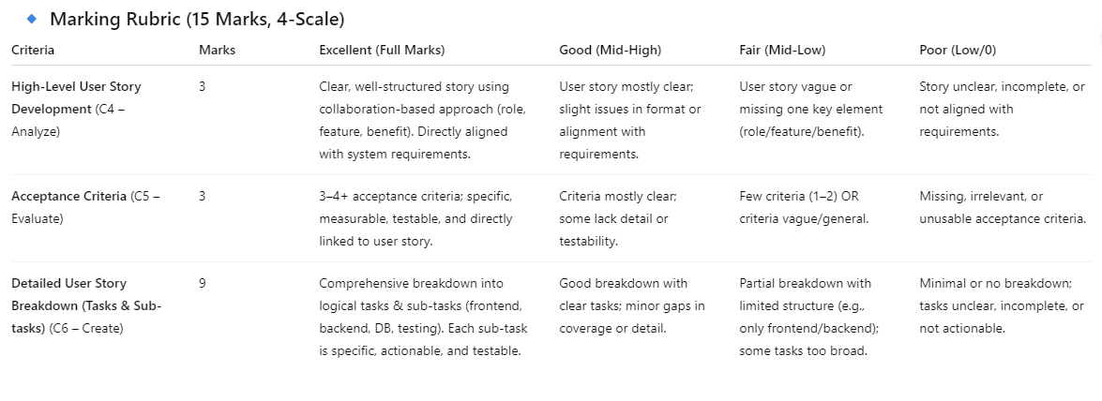
Rubric Assignment #1: User Stories

Slide 84







THANK YOU
In the Name of God for Mankind
www.utm.my

